Slide 1
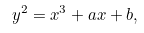
Elliptic Curve Cryptography
An elliptic curve is a set of points that satisfy a specific mathematical equations.

